Slide 1


SUSPICIOUS BEHAVIOR DETECTION IN VIDEO SURVEILLANCE
26/02/2018
VGIS8
Rita Nunes – aviana17@student.aau.dk
Atanas Nikolov - aniko14@student.aau.dk

Slide 2
WHAT IS SUSPICIOUS BEHAVIOR?
Movement in wrong direction
Entry in restricted area
Illegal turns in traffic
Fighting
Crawling
Sudden movements
Etc.
An event can be considered normal in one scenario and anomalous in another scenario.

Slide 3
APPLICATIONS OF SUSPICIOUS BEHAVIOR DETECTION
Traffic monitoring
Crowd analysis
Criminal activity recognition
Surveillance in personal homes, schools, stores, airports, etc.

Slide 4
RELATED WORK

Slide 5
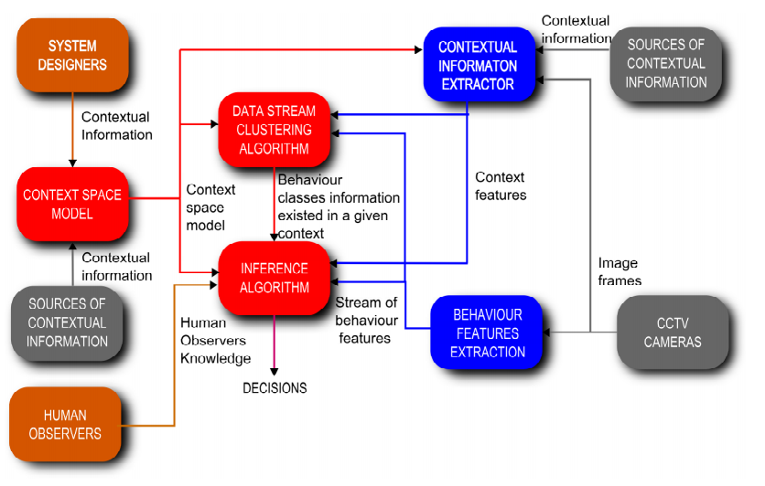
A Suspicious Behavior Detection using a Context Space Model for Smart Surveillance Systems
[2012] Arnold Wiliem, Vamsi Madasu, Wageeh Boles, Prasad Yarlagadda
Suspicious behavior is different from abnormal behavior
Involves subjective human interpretation
Requires general knowledge of human behavior
Exploit contextual information to make more accurate decisions
The red boxes are the main system components;
The clay boxes are sources of information needed
by the system;
The grey boxes are the source of information extracted by the system;
The blue boxes are the system feature extraction components ;

Slide 6
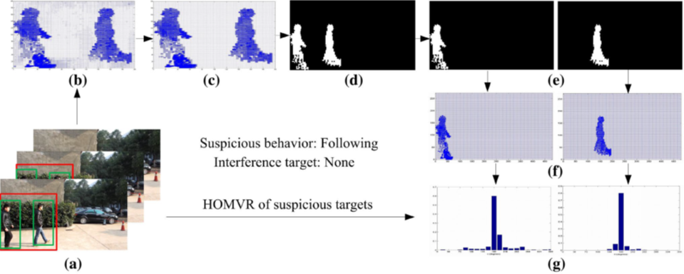
A fast recognition algorithm for suspicious behavior in high definition videos
[2015] Chundi Mu, Jianbin Xie, Wei Yan, Tong Liu, Peiqin Li
Motion vectors are extracted
Suspicious behavior: wandering, trailing, chasing, and falling down
7-D features {θ, V, σθ, σV, Eθ, EV, InterDj} are extracted to describe the targets detected on a frame
SVM is used to learn and classify the input videos
(a) Original video image; (b) Local motion vectors extracted from video streaming; (c) Local motion vectors optimized by the algorithm; (d) Target extracted from motion vectors; (e) Separated targets; (f) Motion vectors for separated targets; (g) Histogram of motion vectors

Slide 7
Expert video-surveillance system for real-time de-tection of suspicious behaviors in shopping malls
[2015] Roberto Arroyo, J. Javier Yebes, Luis M. Bergasa, Iván G. Daza, Javier Almazán
Situations to evaluate: entry or exit of people, loitering events and unattended cash desk situations in the payment area
Innovative tracking method – 1. LSAP (Linear Sum Assignment Problem), Kalman filter (predict future positions); 2. occlusions between objects are managed applying a method based on visual appearance in which image descriptors are tested: GCH (Global Color Histogram), LBP (Local Binary Pattern), HOG (Histogram of Oriented Gradients).
Alarms detected by the expert video-surveillance system in shopping malls.

Slide 8
Multiple Anomalous Activity Detection in Videos
[2017] Sarita Chaudharya, Mohd Aamir Khana, Charul Bhatnagara
Main activities: running, walking and crawling
Features: centroid, movement, speed, direction and dimensions
Concept of dominant set in which dominant behavior (frequently occurring) is treated as normal and less dominant behavior is considered as anomalous
Rule-Based approach to classify events as normal and anomalous
Sequence showing crawling, walking and running activity.

Slide 9
?
?
PROPOSED WORK
?
Still to define…

Slide 10
THANKS!

